Slide 1
One hidden layer
Neural Network
Random Initialization

Slide 2






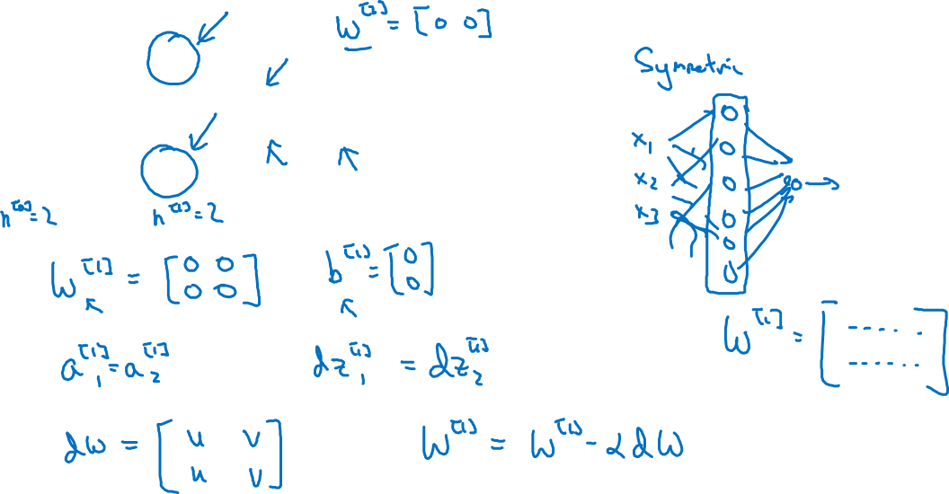
What happens if you initialize weights to zero?
$$x_{1}$$
$$a_{1}^{[1]}$$
$$a_{1}^{[2]}$$
$$\hat{y}$$
$$x_{2}$$
$$a_{2}^{[1]}$$

Slide 3
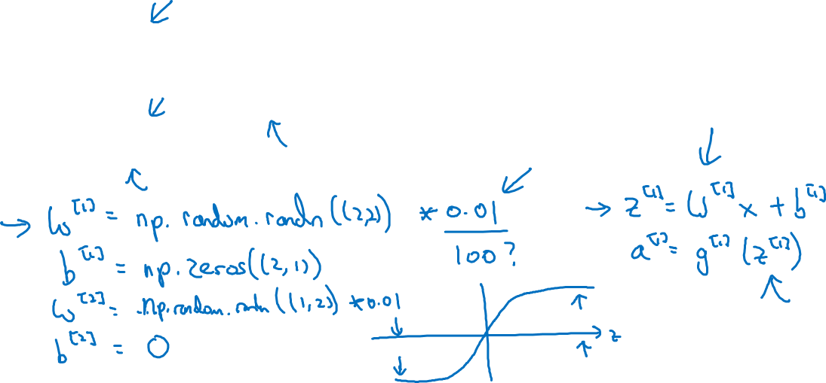
Random initialization
$$x_{1}$$
$$a_{1}^{[1]}$$
$$a_{1}^{[2]}$$
$$\hat{y}$$
否则学习速度会变得很慢
$$x_{2}$$
$$a_{2}^{[1]}$$

